Slide 1
Title: " The Impact of Video Assistant Referee (VAR) Decisions On Teams Performance in Modern Football "
Aditya Santosh Pathak
Post-graduate student

Slide 2
Introduction
Context
VAR system in football was introduced to improve accuracy in the decision making of the game, reducing human errors and creating a fair play.
VAR is a technological intervention that tackles vital moments in a soccer match: goals, penalties, red cards and cases of mistaken identity.
Purpose
It studies the impact that VAR has on the result of matches as well as the effect that it has on maintaining consistent decisions from match to match.
It is about how VAR affects fairness, decision-making practices, and bias.
Changes in Match Variables:
Match Duration:
Decisions on Offside taken by VAR:
Impact of Disallowed Goals:

Slide 3
why is this research necessary?
1. Assessing VAR’s Effectiveness in Fair and Unbiased Decision-Making
VAR was introduced to minimize human error and ensure refereeing decisions are accurate and fair.
This research evaluates whether VAR reduces biases and errors, particularly in critical moments like penalties, goals, or red cards.
The findings can help refine VAR’s implementation and improve fairness in football matches.
2. Addressing Controversies Surrounding VAR’s Impact
VAR decisions have sparked debates due to perceived inconsistencies or favoritism.
High-profile cases of overturned penalties or disallowed goals have raised questions about VAR's neutrality.
This research provides data-driven clarity to separate perception from reality, helping improve VAR's credibility and acceptance.

Slide 4
Literature review
Several studies highlight VAR's potential to enhance refereeing accuracy. For instance, a study by Spitz et al. (2020) found that VAR significantly reduces clear errors, especially in high-stakes matches, thus contributing to fairer outcomes. Another analysis by Bao and Han (2023) observed that the introduction of VAR led to a measurable reduction in incorrect penalty decisions in the English Premier League (EPL). However, the extent to which VAR improves fairness varies, as biases can still occur based on subjective interpretations of incidentsversies Surrounding VAR. Despite its intended purpose, VAR has faced criticism for its inconsistent application and potential to disrupt the game's flow. Research by Munir and Yıldız (2022) emphasized that subjective decisions, such as handballs or fouls, often lead to controversies due to differing interpretations by referees. This inconsistency has fueled debates about whether VAR truly reduces bias or merely introduces new sources of uncertainty.

Slide 5
Research Methodology
Dataset Details
Sample: Data for all 20 Premier League teams.
Key Variables Analyzed:
Overturns: Decisions overturned by VAR.
Goals: Impact of VAR on goals: cast, not given, for and against.
Judgment Calls: Subjective referee verdicts, e.g., handballs, fouls.
Net Scores: Overall impact with metrics like net goal and subjective scores.
Analytical Approach
1.Descriptive Analysis:
Analyze opinions and trends on VAR by club.
2.Impact Analysis:
Investigate how various kinds of choices (factual versus personal) affect game results.
3.Home vs. Away Comparisons:
Determine the impact of VAR on home and away sides.

Slide 6
Key Findings (Descriptive Analysis)
Net Goal Scores
Teams Benefiting from VAR: Example: Brighton (Positive impact on goal scores).
Teams Disadvantaged by VAR: Example: Wolves (Negative impact on goal scores).
Visual Aid:
Bar Chart: Comparing net goal scores for teams benefiting vs. disadvantaged by VAR.
Average Overturns
Mean: Average number of goal overturns across teams.
Median: Central value of goal overturns, minimizing outliers.
Conclusions
VAR's impact is uneven across teams.
Raises questions of fairness in its application.

Slide 7
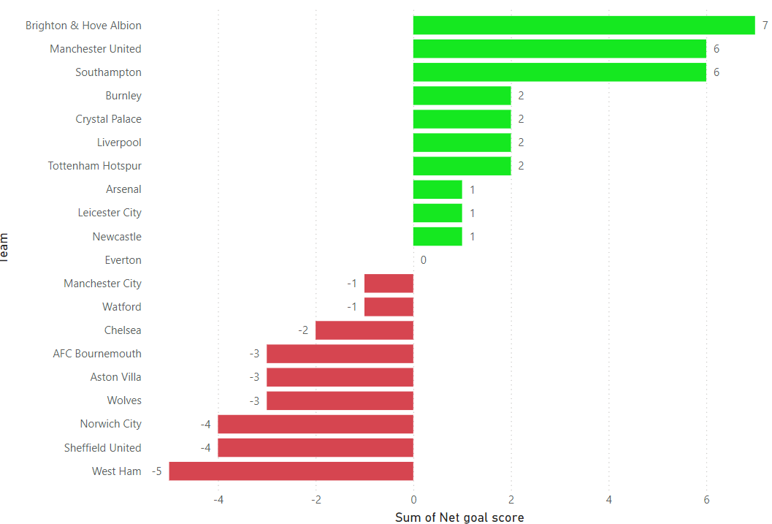

Slide 8
Key Findings (VAR Decision: Impact Analysis of VAR )
Impact of VAR Decisions
‘Objective’ Versus ‘Subjective’ Decisions
Overturns:
Objective decisions
The VAR decisions that most directly impact the outcome of matches by changing goal rulings.
Subjective Decisions:
Seem to be shared more evenly across teams, also less dramatic impact on outcomes
Cancelled Goals
Psychological Influence:
Cancelling goals impacts team morale and performance with both immediate mental and strategic implications.
Strategic Influence:
A goal cancellation may change start strategy as teams can come out more aggressive or alter their plan.
Conclusion
•Overturns have the greatest effect on match outcome and often change the flow of a match.
• Subjective decisions appear to have a more balanced impact, indicating VAR’s moderating role in referees’ biases.
•Disallowed goals have an effect on teams both mentally and tactically, making the cost of VAR much greater than simply the result on the scoreboard.
•The longer VAR is part of the top-level game the more psychological and tactical consequences it will produce, highlighting the need for a uniform and fair application to achieve competitive fairness.

Slide 9
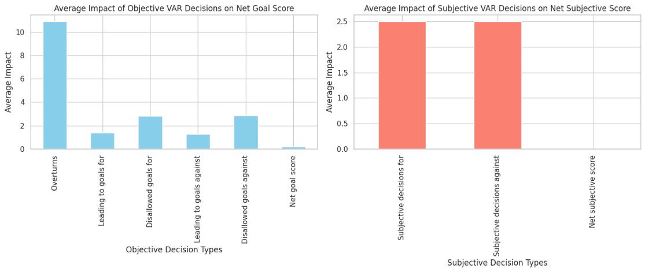

Slide 10
Key Findings (Home vs. Away Analysis)
Aim: To analyse the bias effect of VAR decisions on home and away teams.
Key Assumptions:
Crowd effects (goals for, disallowed goals for) may be advantageous to home teams.
So away teams may be disadvantaged (goals against leading to goals against, disallowed goals against).
Impact Scores:
Home Impact Score = Goals for – Disallowed goals for
Away Impact Score = Goals for with goals against – Goals against with goals for
Hypothesis Testing:
Results of the paired t-test indicated p-value = 0.7923, suggesting no difference between the impact scores comparing home to away.
Conclusion:
VAR calls are not a significant advantage or disadvantage to home teams.

Slide 11
Conclusion
Overall Impact:
Manchester United and Brighton have benefitted from VAR marginally on average, while there have been a couple of goal/case incidents negatively impacting Aston Villa and Sheffield United, so the fairness of it all is hard to judge.
VAR Consistency:
No major bias between home and away teams detected (p > 0.05), indicating consistent and neutral application of VAR.
Impact on Game Flow:
VAR interventions are not limited to just on-field refereeing, but also involve team strategies and game flow and we've seen goals disallowed, penalties overturned and plenty more potential goals turned into high-pressure situations.
Perception of Bias:
The data do not bear out claims of bias, and this is also true of SEC bias, which means that such claims are based on perception rather than evidence.
.

Slide 12
Takeaway Final: VAR Is Accessible?
Takeaway Final: VAR Is Accessible?
Yes, but with limitations. VAR helps increase decision correctness, particularly for decisions that need to overturn erroneous on-field calls. But it is not equally beneficial for all teams and frequent usage may break the rhythm of play. Referees of the future need to be better trained and have more clearly defined frameworks for how VAR is used, with more intention behind its use — if such measures will increase levels of consistency and reduce apprehension towards it from clubs and supporters.

Slide 13
references
1.Link to the collab file where I performed analysis
Pathak, A. (2024). Analysis Code for VAR Impact Study. Google Colab. Available at: https://colab.research.google.com/drive/1ans5pDYxCbGKiMWEkGXxefpGS23WipIY?usp=sharing.
The analysis utilized a dataset from Kaggle compiled by S. Joshi [1].
[1] S. Joshi, "FIFA Video Assistant Referees (VAR)" Kaggle, 2023. [Online]. Available:
https://www.kaggle.com/datasets/sauravjoshi23/fifa-video-assistant-referees-var

